Slide 1


Turtle Games Customer Insight Strategy

Slide 2
Our objectives
Scope how customers accumulate loyalty points
Hone in on customer segments to target with tailored marketing strategies
Examine customer reviews to inform future marketing campaigns
Leveridge the impact of each product on sales
Learn the relationship between global sales and regional sales to inform sales strategy

Slide 3
Customer loyalty behaviours
We used Python to analyse customer age, wage and spending data and how these affected loyalty scores. We created a multiple regression model to determine how these variables affected loyalty points.
From the model, we can determine that a +1 increase in age is linked with an increase of ~ 11 loyalty points. Meanwhile, a +1 increase in wage is linked with a ~ 34 increase in loyalty points. Similarly, a 1 unit increase in spending score is linked with +34 loyalty points. Therefore, wage and spending scores are the two largest factors in increasing loyalty scores while age does play a role albeit slightly smaller.
Actionable Insights
Target high-income customers – Loyalty points are positively correlated with income (wages) therefore the marketing team could create marketing campaigns which target this demographic. For example, we could release a limited ultra-premium version of triple AAA games with in-game exclusive content such as unique skins or call tags as well as granting early access to the game.
Incentivise increased customer spending – The marketing team could release promotions or deals which encourage customers to spend more. For example, they can release gaming genre bundles or introduce a monthly season pass for competitive online games. Spending can be further encouraged by selling more cosmetic items in-game.
Enhance the customer loyalty programme – Inversely, we could improve the customer loyalty programme to further enhance customer spending. For example, we can provide discounts or rewards to customers who spend above a certain threshold such as exclusive communities or personalised experiences.

Slide 4
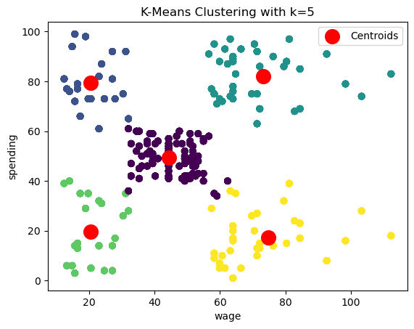
Customer segmentation – determining who are customers are
We were tasked with identifying groups within the Turtle Games customer base that can be used to target specific marketing campaigns. We plotted customer spending against wages in a scatterplot to determine if customer spending behaviour could be clustered into specific.
We used the elbow and the Silhouette methods to determine that there were 5 distinct groups in the data.

Slide 5
Customer Groups
Low Income, Low Spend – Focus on value for money – Offering services such as EA Play, a low-cost monthly membership which allows users to access a large library of games. We could also offer highly desirable premium games at a low-cost, interest-free monthly payment plan
Low Income, High Spend – This group is clearly dedicated to the services we offer. Again, we can offer value-for-money products and memberships. We could also reward their dedication by providing exclusive content or beta testing opportunities.
Moderate income, Moderate Spend – To maintain this group, we must blend a mixture of quality and price to satisfy their current spending. We could also seek to increase their spending by offering exclusive spending incentives or advertising exclusively premium content to them.
High Income, Low Spend – This group is cautious with how they spend their income so we must emphasise value for money with our offers. Here, offering ultra-premium bundles and add-ons will be fruitful as well as flexible payment plans.
High Income, High Spend – Target this group with ultra-premium exclusive personalised content as well, early access to the games as well as exclusive communities and gifts. We want the loyalty of these customers especially, so we must make them feel valued.

Slide 6
Utilising Customer reviews to inform Future marketing Campaigns
We gathered reviews from Turtle Game’s website into a data frame then and used Natural Language Processing libraries in Python to analyse the data frame to gauge customer sentiment in these reviews.
The vast majority of reviews scored positive sentiment scores as reflected in the mean sentiment polarity score and the customer sentiment distribution chart. We mainly coded the top 20 reviews by sentiment and noted the most positive reviews appreciated engaging games, high-quality build quality, accessible games and good value for money.
In terms of future marketing campaigns, we should highlight these factors in communication to create engaging and persuasive campaigns. For example, emphasising build quality and accessibility of games. We should also target specific communications to customers who are most likely going to appreciate certain features. For example, a low-income low spending customer may be persuaded by value-for-money marketing while a family may resonate more with engaging or accessible content.

Slide 7
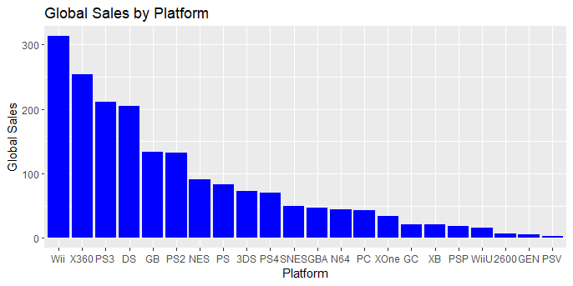
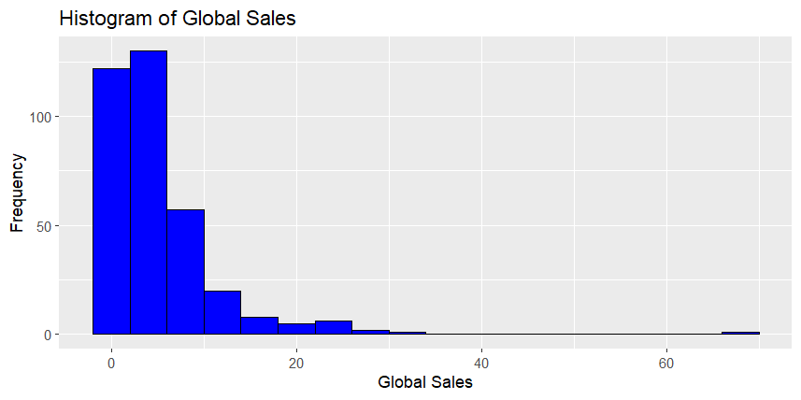
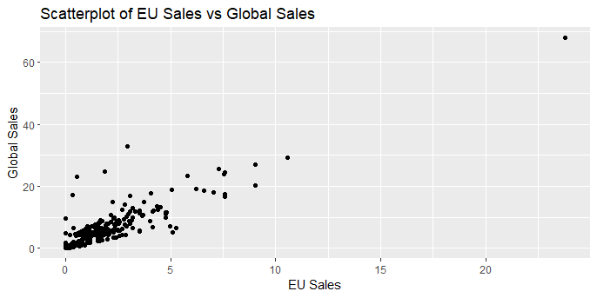
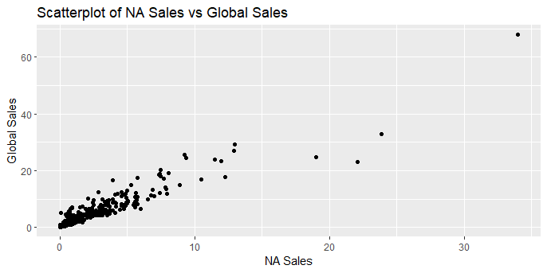
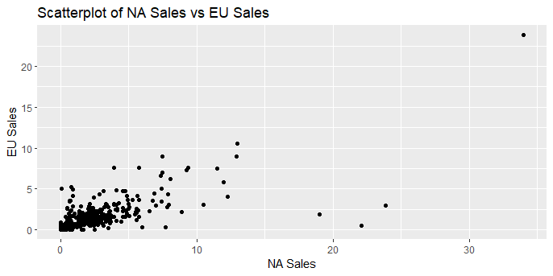
Understanding and contextualising sales data
We used the programming language R to analyse sales data across global sales, EU sales and NA sales as well as products and gaming platforms. R was utilised as it has superior libraries and tools for the statistical modelling that we conducted on the dataset.

Slide 8
Understanding and contextualising sales data
We used a Correlation Matrix in R to determine the relationship between the different regions and sales.
The correlation between North America and Global sales is 0.93, indicating a very strong relationship.
The correlation between EU and Global sales is 0.88, indicating a strong relationship but not as strong as that of North America and Global sales.
The correlation between EU and North America is 0.70 which indicates a decently strong relationship.
Actionable Insights
Prioritise resources towards the North American market – This market has the greatest correlation with global sales therefore success in this market will most likely align with success on a global front.
Learn from the success of the North American Market – Analyse the key factors driving success in the US market and leverage these factors in other markets.
Focus on highly sought-after products and remove dead inventory - The right-leaning histograms and the high IQR indicate that there are a few games which drive the majority of the sales. There is also a significant amount of games which simply do not sell. Turtle Games must focus marketing and sales efforts on games which yield huge market demand.

Slide 9
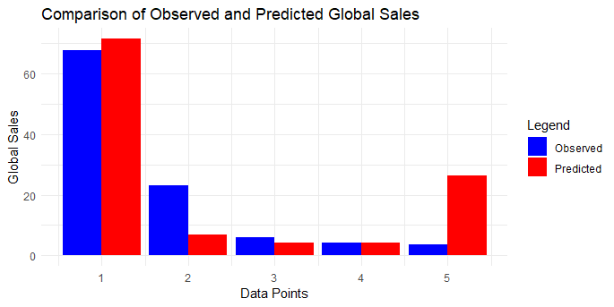
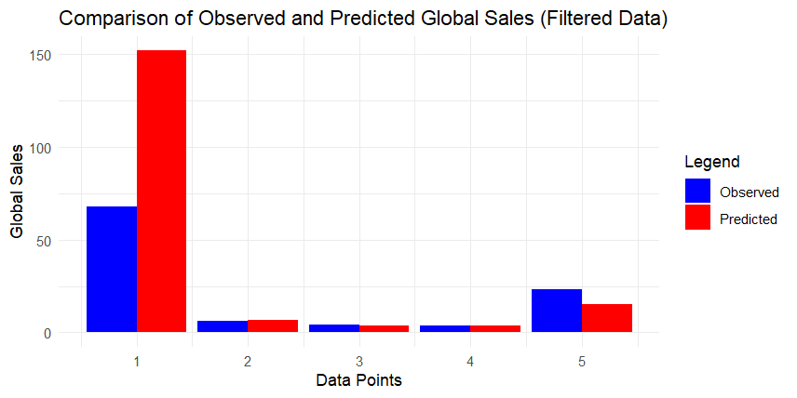
Predicting future Sales
We created linear regression models to analyse the sales data in addition to predicting future models. The initial model which was composed of all the data points was unreliable as the presence of outliers skewed the data massively. Regression models must be normally distributed to be reliable.
We created a cleaned version of the dataset, which removed all outliers so that the model that was generated was normally distributed and reliable. The comparison between observed and predicted values was closely matched. However, this model was also unreliable as it did not contain outlier products which made the majority of sales.

Slide 10
Conclusion
In summary, this report provides Turtle Games with important insights into customer behaviour and sales strategies. By following these recommendations, the company has a strong chance of increasing sales. It's crucial to continue researching and analysing the market to build on these insights and develop a well-rounded strategy to consistently grow global sales. By staying in tune with customer preferences and market trends, Turtle Games can remain competitive and effectively cater to its diverse audience.

